Slide 1

PY 620 Class 2
Looking at data.
Bar Charts and Histograms.
Graphing data.
Tables.
Measures of Central Tendency.
Why outliers are important.

Slide 2
Looking at Data
Bar Charts and Histograms
Stem and Leaf plots.
Frequency Polygrams.
Tables.

Slide 3
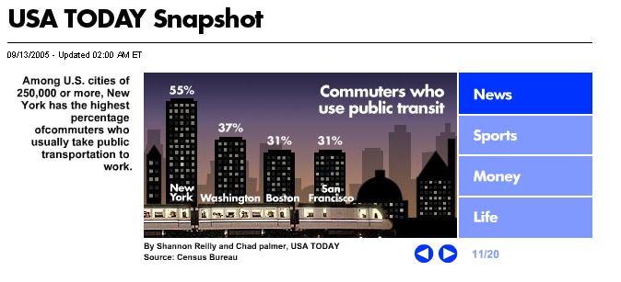
USA Today Snapshot

Slide 4
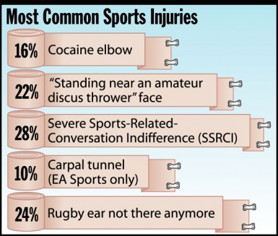
Onion Statshot

Slide 5
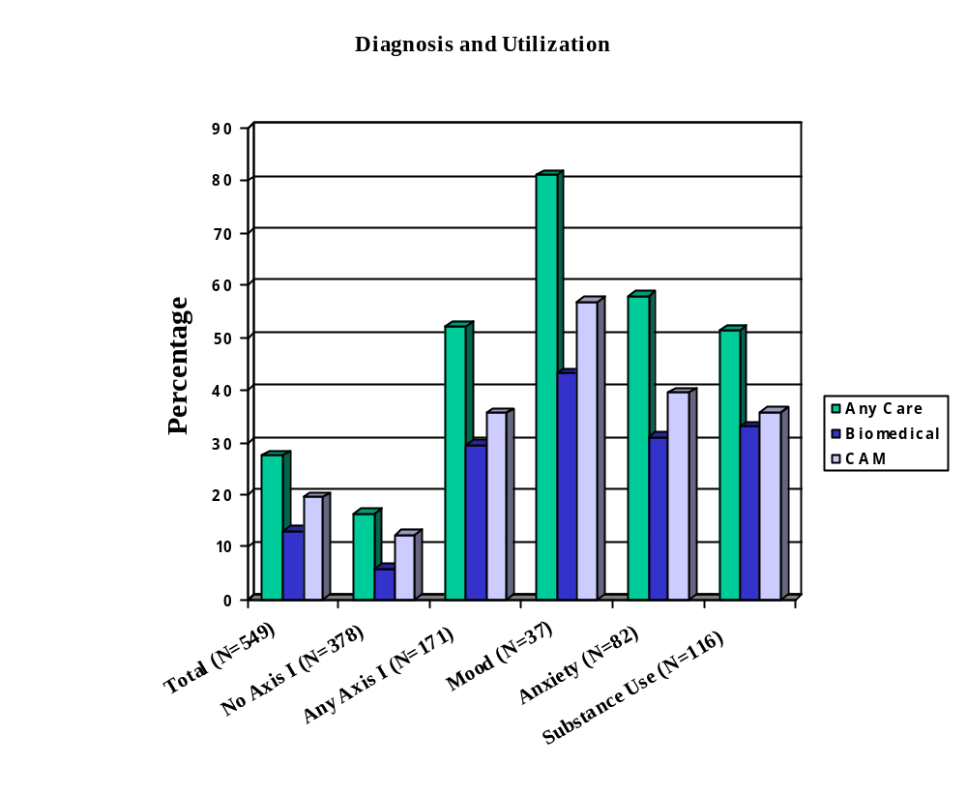

Slide 6
Some of our data: raw numbers
4 | 4 | 5
5 | 5 | 2
2 | 5 | 2
4 | 2 | 3
4 | 3
4 | 4
3 | 3
4 | 4

Slide 7
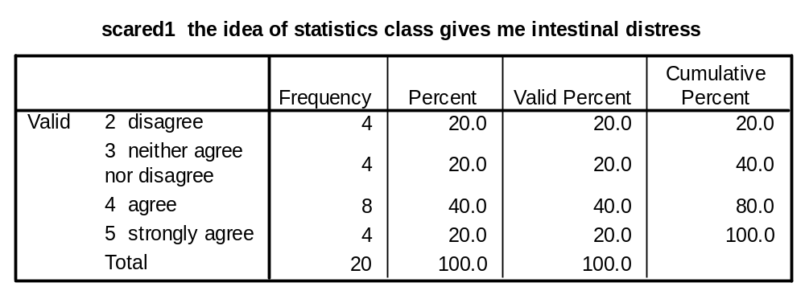
Our data: in a table

Slide 8
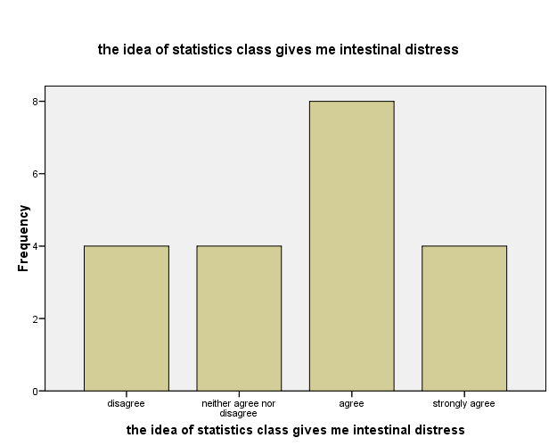
Our data: In a bar chart with counts

Slide 9
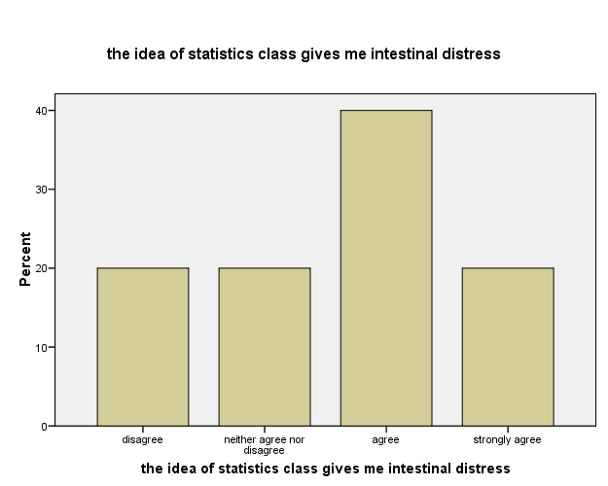
Our data: In a bar chart with percentages

Slide 10
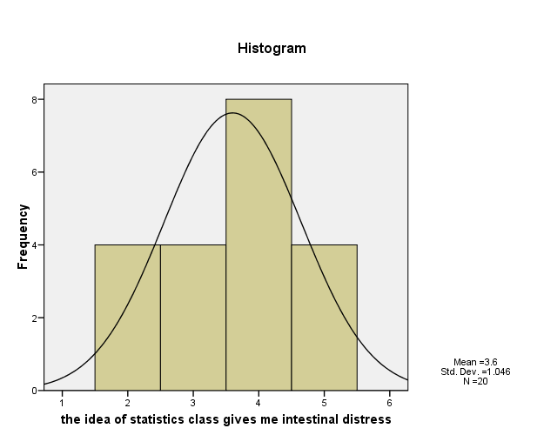
A Histogram with a Normal Curve

Slide 11
Stem and Leaf Plots
The idea of taking statistics gives me intestinal distress Stem-and-Leaf Plot
Frequency Stem & Leaf
4.00 2 . 0000
4.00 3 . 0000
8.00 4 . 00000000
4.00 5 . 0000
Stem width: 1
Each leaf: 1 case(s)
Stem and Leaf plots combine elements of both a table and a graph.

Slide 12
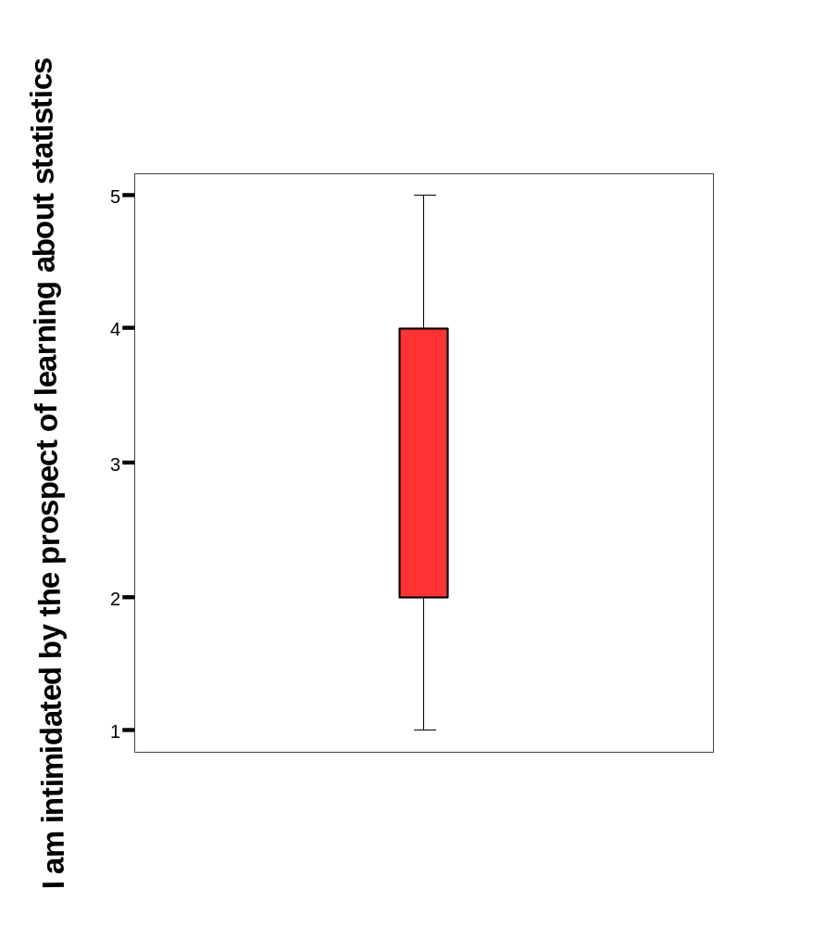
A box plot

Slide 13
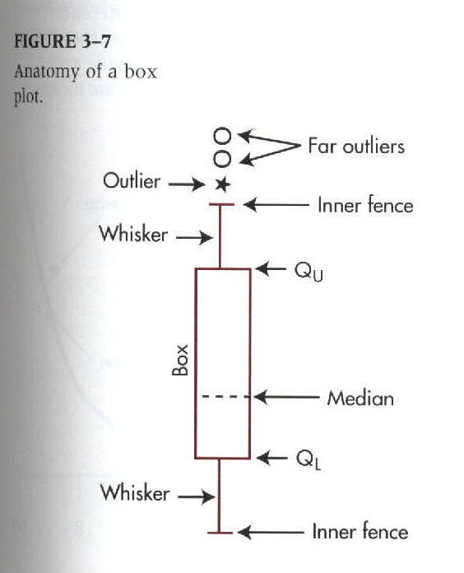
Box Plots
Developed by John Tukey as a way of easily visualizing data distributions.
Box encloses the middle 50% of data. "Fences" enclose 95% of data. Outliers are beyond these limits.

Slide 14
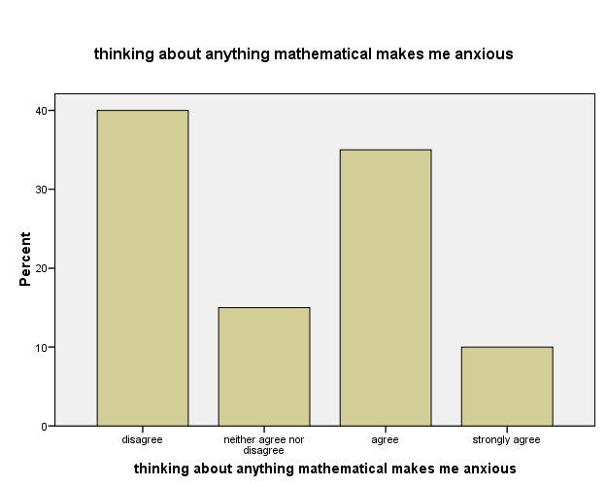
More data in a bar chart

Slide 15
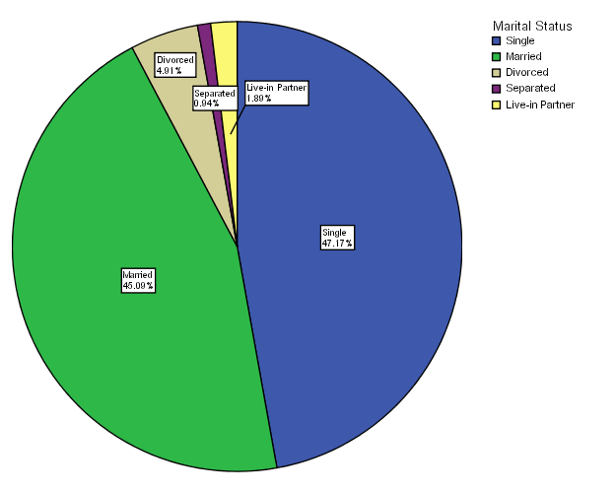
Sometimes a pie chart works best

Slide 16
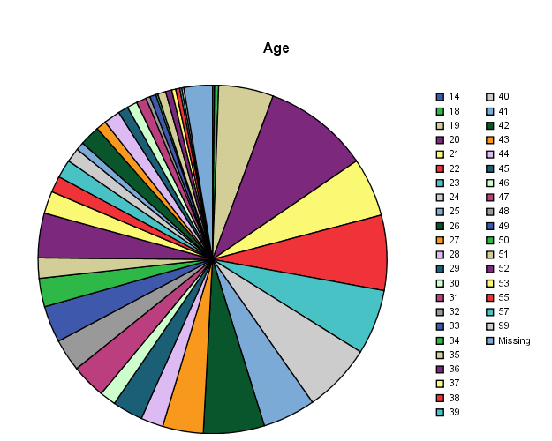
Sometimes a pie chart doesn't makes sense at all

Slide 17
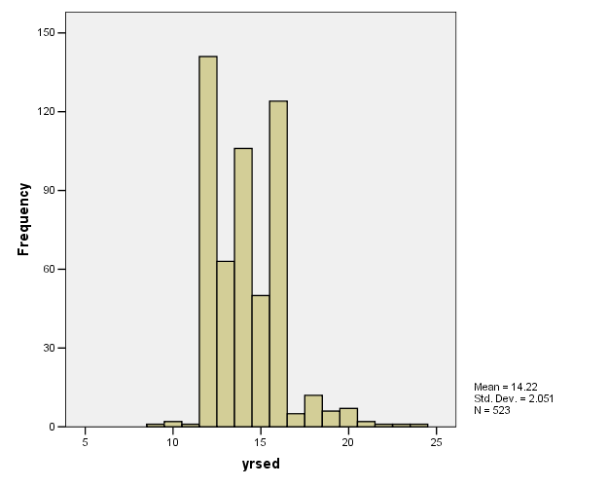
Histogram of Years of Education

Slide 18
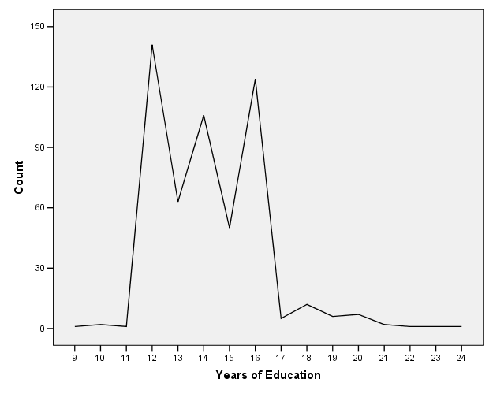
Education as frequency polygram

Slide 19
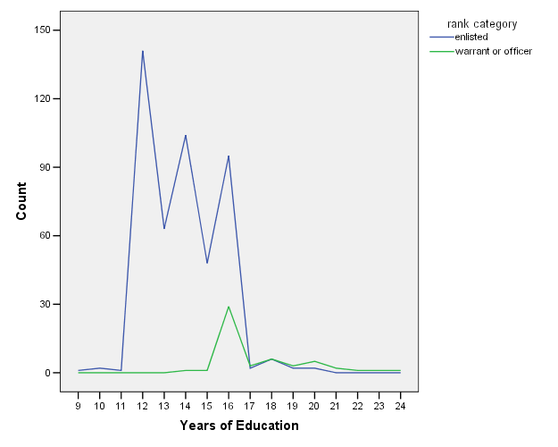
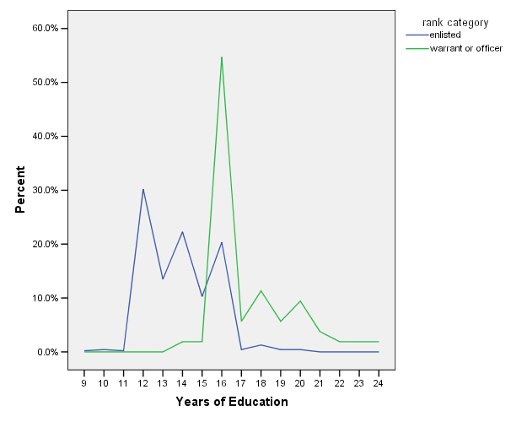
Multiple Frequency Polygrams

Slide 20
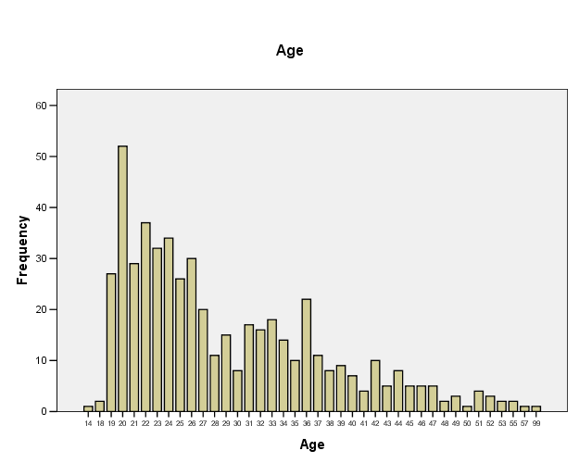
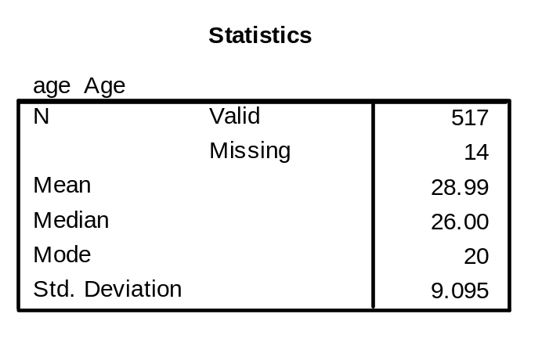
Looking at Data: MNNG Age

Slide 21
Looking Closely at Data: MNNG Age

Slide 22
Measures of Central Tendency:Mean
arithmetic average
sum of the observations divided by the number of observations (e.g. SCARED1 72/20 = 3.60)
“balance point” of the distribution > changing any single number changes the mean of the sample
sum of the deviations about the mean is zero
appropriate for ordinal, interval & ratio data
independent of sample size

Slide 23
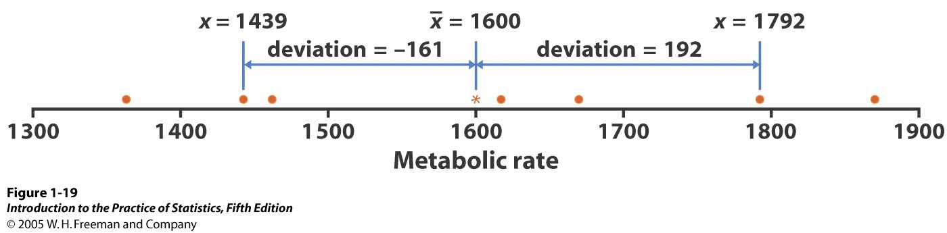

Slide 24
Measures of Central Tendency:Median
median is the “middle-most” point of the distribution when ordered from lowest to highest score.
the point at or below which 50% of the cases fall
order the cases
for odd number cases, it is the middle most score (i.e., the score at [(N + 1)/2] (in this case 11)
for even number scores, it is the score midway between N/2 and N/2+1
less sensitive to extreme scores
does not take into account all scores > changing one score may not change median
appropriate for skewed distributions, e.g., reaction time, income
appropriate for ordinal, interval & ratio data
independent of sample size

Slide 25
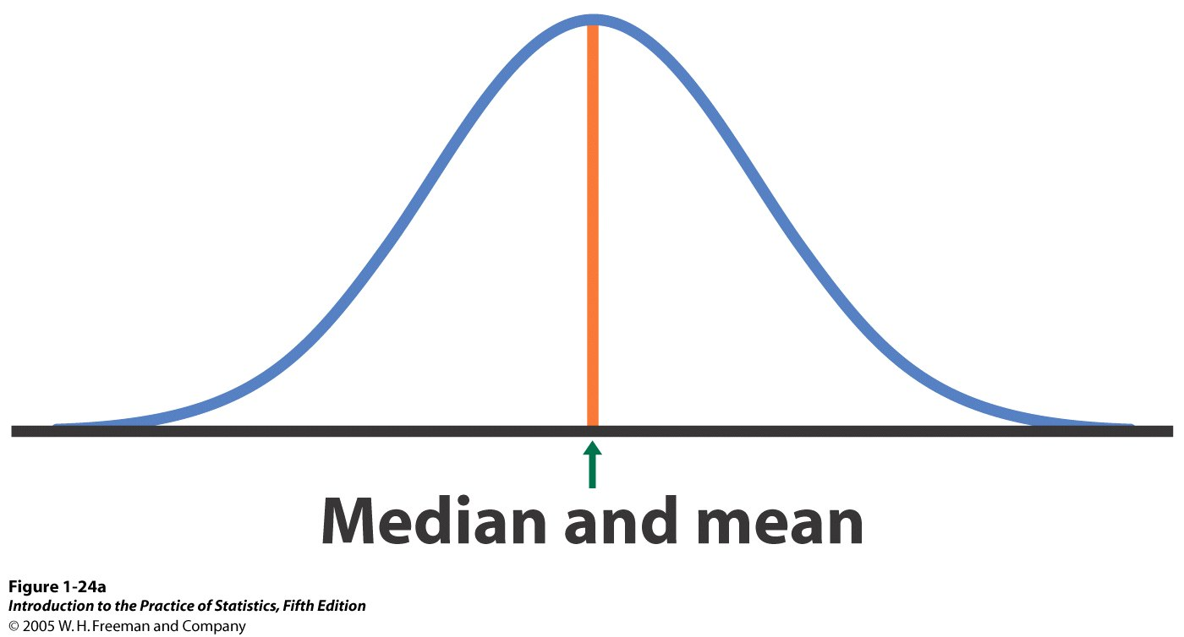

Slide 26
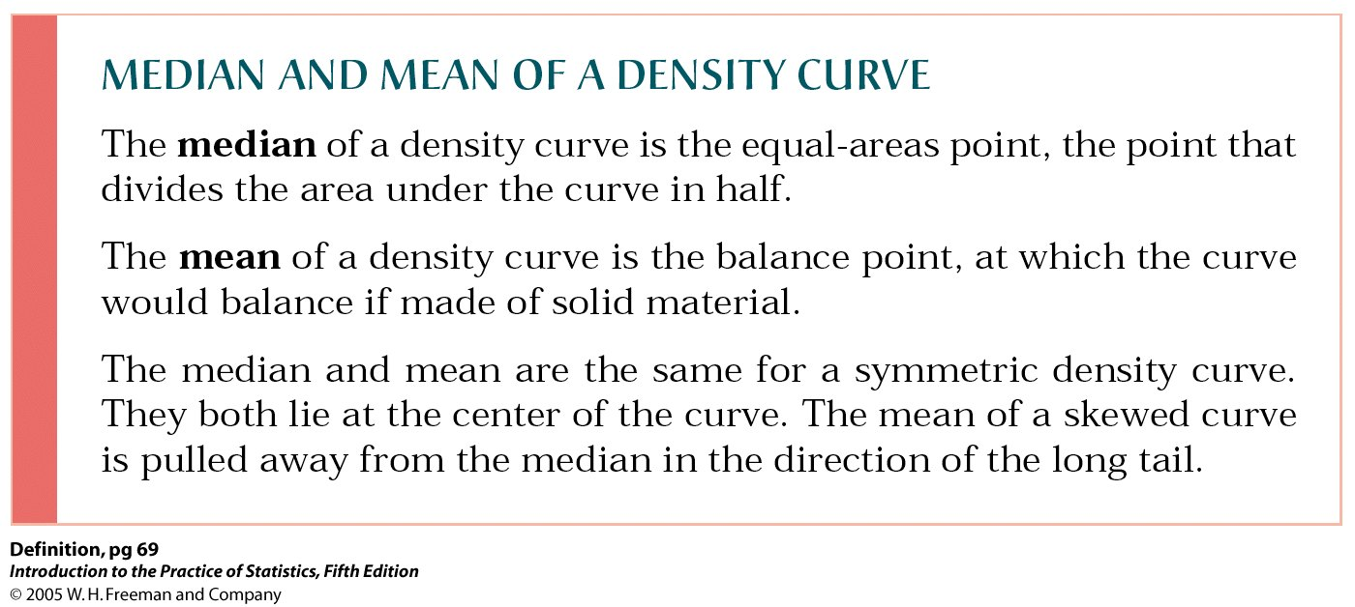

Slide 27
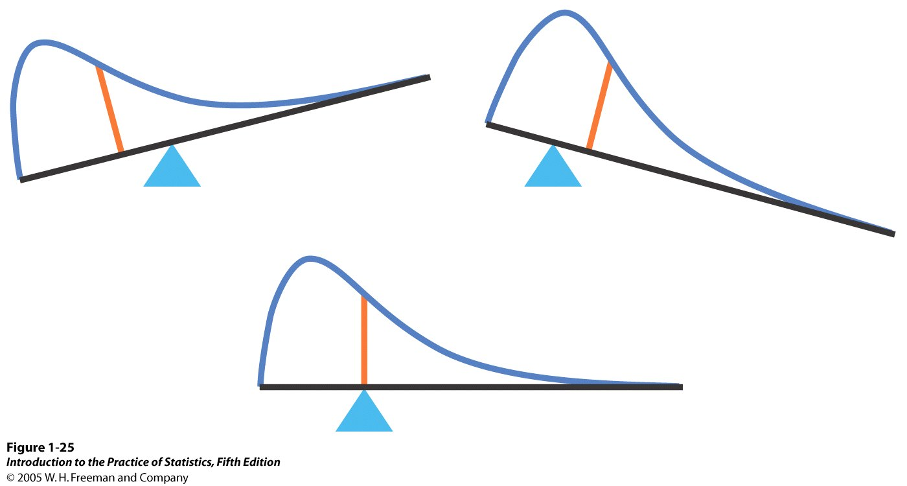

Slide 28
Measures of Central Tendency:Mode
most frequently occurring score
appropriate for any scale of measurement
least sensitive to changes in scores
distributions may be bimodal
not informative if used for continuous measures with infinite number of values
independent of sample size

Slide 29
Measures of Dispersion:Range
difference between the largest and smallest scores
ease of computation and interpretation
determined by only 2 scores (minimum & maximum)
changing any other score will have no effect on range

Slide 30
Skewness
index of symmetry
calculated as 3 times difference between mean & median divided by SD
sign and magnitude indicate direction (positive & negative) and degree of asymmetry
normal curve has skew of 0
informative about relative location of mean, median & mode

Slide 31
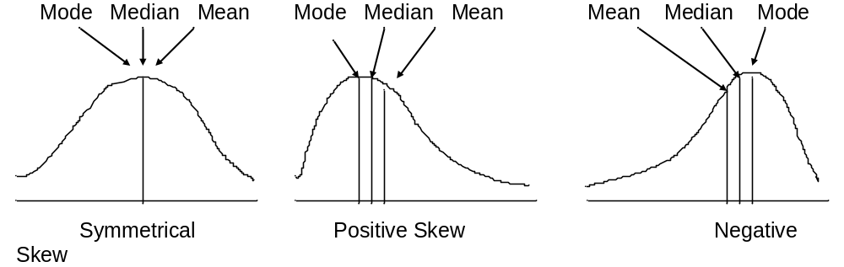
Examples of Skew

Slide 32
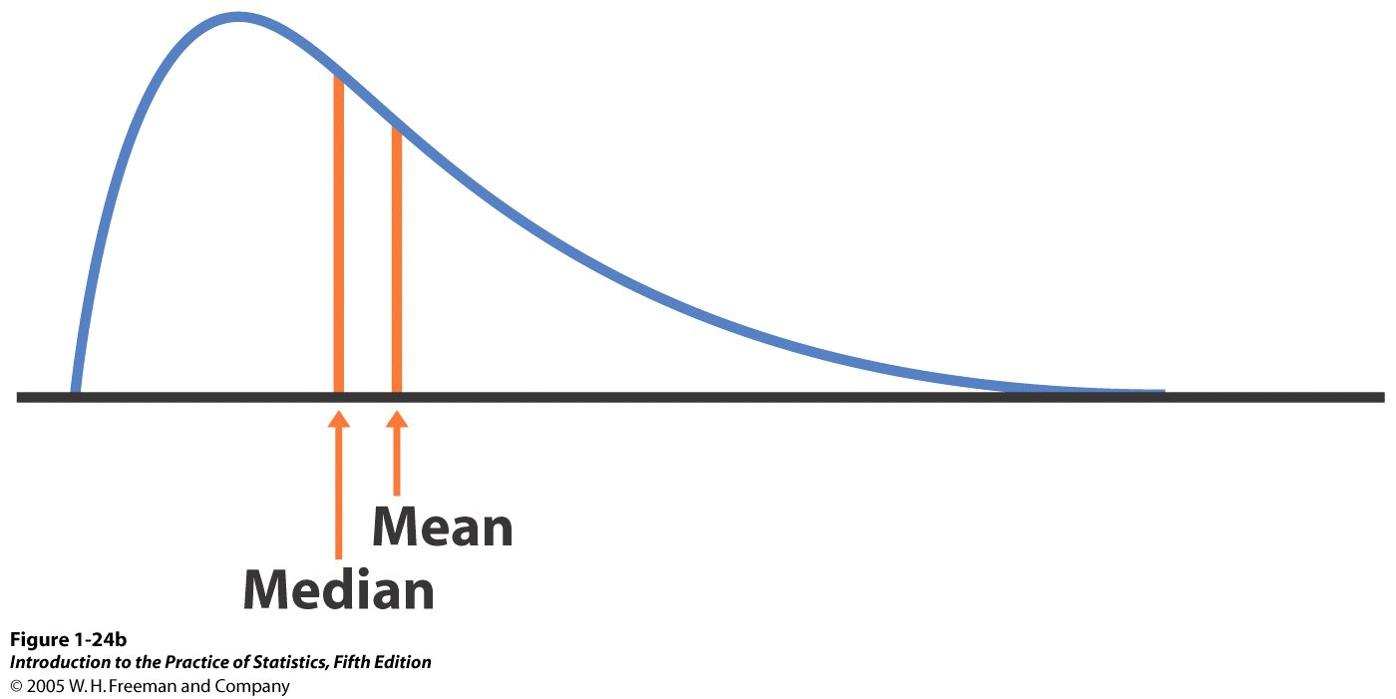

Slide 33
Interquartile Range
Problems with Range
  can change wildly with outlyers.
  As sample grows, range is likely to grow.
Interquartile range is the difference between the upper quarter and lower quarter of the data- the middle 50%.
Less affected by extreme scores.

Slide 34
Variance and Standard Deviation
We need to measure the "spread" of data around the mean value. One way to do this is to take the difference between an individual value and the mean value and square it. Why square it? To get rid of negative values.
In other words, take the difference from the mean, square it, and add them all up and divide by the total sample size.
For example in the scared data, scared1 has a variance of 1.095

Slide 35
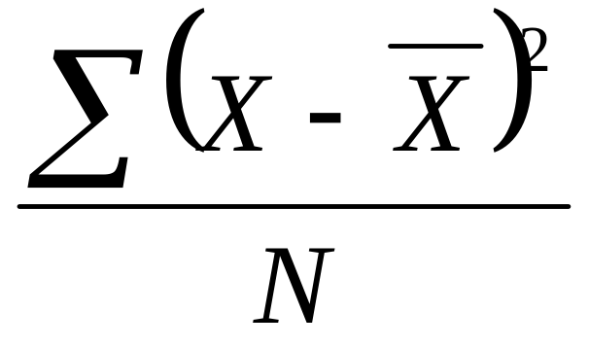
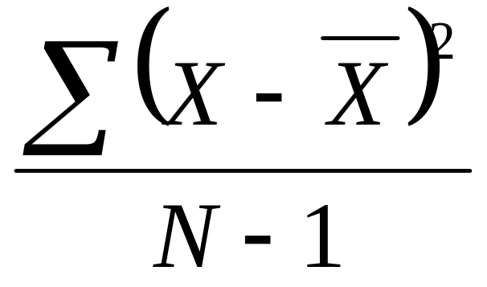
Formula for Variance
This is the formula for calculating the variance of a population. The X represents an individual value, the x with a line over it represents the mean. To summarize, this formula tells you to subtract each individual value from the mean, square that difference, and then add them all up and divide by the size of your sample.
Since we almost always have a sample instead of a population, we use a slightly different formula. Instead of dividing by the number in the sample, you divide by that number, minus 1.

Slide 36
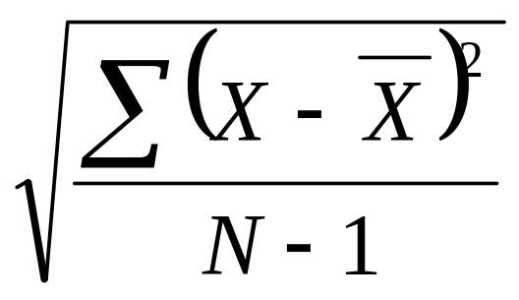
Standard Deviation
To make the nonsense number from variance make more sense, you use the following formula.
This puts the whole thing back into original units. In the case of Scared1, 1.046.

Slide 37
